Slide 1

ENERGY METERING & SHOP BILLING
Watch Dog EM
Watch Every Watt
A professional local platform that turns real meter readings into clear, controlled and auditable shop billing.
WATCH EVERY WATT
Owner presentation · By MicroBrain
Notes:
Open with the business outcome: Watch Dog EM gives ownership one controlled chain from energy consumption to invoice and collection. Keep the opening short and move directly to the operational problem.
[Sources]
- Internal product: README.md
- Brand asset: wwwroot/images/watch-dog-logo-visible.png

Slide 2
WATCH DOG EM
The real challenge is trusted billing visibility
Owners need more than meter values. They need a reliable link between consumption, tenant charges, invoices and payment status.
Without one system
With Watch Dog EM
Manual reconciliation
One operational record
Readings, tariffs and tenant records can live in separate places.
Meters, shops, tariffs, invoices and payments stay connected.
Slow exception handling
Management by exception
Communication failures and unusual readings are harder to spot early.
The dashboard highlights status, alarms, balances and billing progress.
Watch Every Watt · By MicroBrain
02
Notes:
Frame the product as a control system for the business, not only a technical meter reader. The value is traceability: every billed amount can be followed back to a meter, tariff and billing period.
[Sources]
- Internal product model: Models/Domain.cs
- Live dashboard: Pages/Index.cshtml

Slide 3
WATCH DOG EM
One platform connects energy data to money
01
Acquire
02
Monitor
Poll physical meters through Modbus RTU controllers and store timestamped readings.
Show accumulated energy, communication condition and the latest successful reading.
03
Bill
04
Collect
Apply the effective tariff for each meter and calculate monthly consumption and charges.
Track invoice status, payments, balances and collection rate by currency.
Watch Every Watt · By MicroBrain
03
Notes:
Walk clockwise through the four capabilities. Emphasize that they are connected records in one database, so ownership can move from reading to revenue without rebuilding the information each month.
[Sources]
- Internal product model: ApplicationDbContext.cs and Models/Domain.cs
- Internal services: MeterPollingService.cs, BillingCalculator.cs

Slide 4
WATCH DOG EM
From controller reading to invoice—automatically
1
2
3
4
5
Controller
Meter channel
Reading store
Billing engine
Invoice & payment
Reads registers over Windows serial / RS-485.
Decodes data type, word order and scale.
Keeps the value, timestamp and source.
Calculates consumption × effective tariff.
Produces PDF and tracks balance status.
Every stage remains reviewable by an authorized user.
Watch Every Watt · By MicroBrain
04
Notes:
Explain this as the product's control chain. The PLC or DDC provides registers, the controller communication reads them, channel configuration converts them to engineering values, and the billing engine creates the financial result.
[Sources]
- Internal Modbus implementation: Services/ModbusRtuService.cs
- Internal polling: Services/MeterPollingService.cs
- Internal billing: Services/BillingCalculator.cs

Slide 5
WATCH DOG EM
One controller manages up to 36 meter channels
The system is designed to grow by adding controllers. Each channel has its own register, meter identity, shop assignment and conversion settings.
Channels 1–12
MODBUS RTU
CONTROLLER
SHOPS /
TENANTS
Channels 13–24
One meter assignment
One tariff history
One billing record
COM port · baud · parity
slave · timeout · retries
Channels 25–36
Watch Every Watt · By MicroBrain
05
Notes:
Clarify that 36 is the configured channel limit per controller, not the limit of the whole installation. Expansion means adding another controller and assigning its meter channels and registers.
[Sources]
- Internal product: README.md
- Controller channel UI: Pages/Admin/Controllers/Channels.cshtml

Slide 6
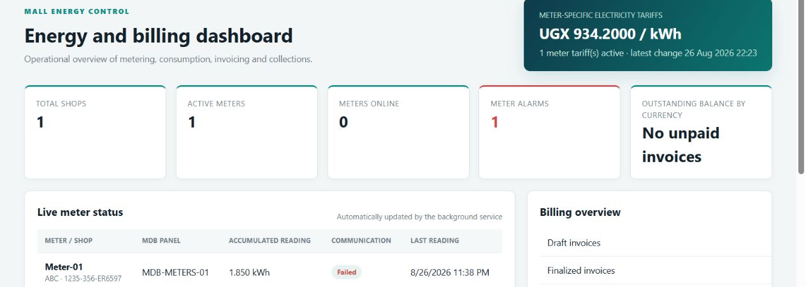
WATCH DOG EM
The dashboard highlights exceptions immediately
At a glance: shops · meters · alarms · tariff · live readings · invoice status · balances
Watch Every Watt · By MicroBrain
06
Notes:
Use the screenshot to orient the owner. Point out the tariff summary, communication alarms, live reading status, billing overview and outstanding balance. The displayed values are current local test data, not a promised operating result.
[Sources]
- Live local product screenshot captured from http://localhost:5080/ on 27 Aug 2026
- Dashboard source: Pages/Index.cshtml and Index.cshtml.cs

Slide 7
WATCH DOG EM
Every shop can have its own tariff and currency
Meter-specific pricing
Selectable currency
Each meter keeps an effective-dated tariff history. Shop 1 can use one price per kWh while Shop 2 uses another.
Tariffs, invoices, payments, balances and collection rates carry their currency code—supporting local operation in Uganda and other markets.
The correct tariff is selected for the billing date.
Dashboard totals remain separated by currency.
Consumption = closing − opening • Charge = consumption × tariff
Watch Every Watt · By MicroBrain
07
Notes:
Give a simple example verbally if useful: two shops may have different effective tariffs, and the invoice stores the tariff and currency used. Avoid discussing exchange-rate conversion because the product reports balances by currency rather than converting them.
[Sources]
- Internal tariff model: Models/Domain.cs
- Internal tariff selection: Services/TariffResolver.cs
- Internal dashboard currency grouping: Pages/Index.cshtml.cs
- Internal calculation: Services/BillingCalculator.cs

Slide 8
WATCH DOG EM
Monthly billing is controlled and repeatable
1
2
3
4
5
Open period
Capture readings
Calculate
Finalize
Collect
Define the month and due date.
Use automatic readings or an authorized correction.
Apply tariff, fixed charges, tax and adjustments.
Lock the invoice and preserve its billing snapshot.
Record payments and monitor remaining balances.
Finalization turns a calculation into a controlled customer document.
Watch Every Watt · By MicroBrain
08
Notes:
Explain the month-end rhythm. Readings are captured, the bill is calculated, then finalization locks the commercial record. Payments update invoice status from finalized to partially paid or paid.
[Sources]
- Internal billing lifecycle: Models/Domain.cs
- Internal operations UI: Pages/Operations/Index.cshtml
- Internal invoice view and PDF: Pages/Invoices/Details.cshtml

Slide 9
WATCH DOG EM
Administrator controls protect the system
01
Communication
02
Meter registers
Configure COM port, baud, parity, slave, timeout and retries; perform a real Function 03 test.
Assign up to 36 channels per controller with data type, word order, scaling and shop.
03
Governance
04
Resilience
Administrator-only setup, role-based access and audit history for configuration changes.
Create and restore database backups; export readings for independent analysis.
Watch Every Watt · By MicroBrain
09
Notes:
This slide addresses control risk. Communication and register settings are restricted to administrators. Changes create audit records, and the application provides backup and restore operations. Mention that deletion actions require confirmation.
[Sources]
- Authorization: Program.cs
- Controller configuration and test: Pages/Admin/Controllers/Edit.cshtml
- Audit behavior: Pages/Admin/Controllers/*.cs
- Backup and restore: Pages/Operations/Index.cshtml.cs

Slide 10
WATCH DOG EM
Local, self-contained and expandable
Watch Dog EM runs as a local web application on a Windows PC or server, keeping the operational database on the customer-controlled machine.
Windows x64
No separate .NET
36 channels
Packaged installer with desktop and Start menu shortcuts.
The release contains the required runtime for direct installation.
Per controller, with expansion through additional controllers.
Watch Every Watt · By MicroBrain
10
Notes:
Position local deployment as direct operational ownership. The installer is self-contained. Customer data and backups are stored outside the program directory so upgrades do not replace them. Network access to other devices can be configured separately if required.
[Sources]
- Internal installation guide: README.md
- Installer definition: installer/WatchDogEM.iss
- Data paths: Program.cs and Services/AppDataPaths.cs

Slide 11
RECOMMENDED NEXT STEP
Approve a controlled pilot
Prove communication, billing accuracy and the monthly operating process on a limited set of real meters before full rollout.
01
02
03
Commission
Validate
Operate
Confirm RS-485 wiring, serial settings, slave address and register map.
Compare system readings and sample invoices against approved manual checks.
Run one billing cycle, review exceptions and agree the expansion plan.
Decision requested: approve pilot scope, site access and responsible owner representatives.
WATCH DOG EM · WATCH EVERY WATT · BY MICROBrain
Notes:
Close with a concrete, low-risk decision. The pilot should prove the physical communication path, the meter conversion, billing calculations and the owner's review process before adding more controllers and meters.
[Sources]
- Recommended implementation approach derived from the product's commissioning workflow
- Internal communication test flow: Pages/Admin/Controllers/Edit.cshtml

